Slide 1
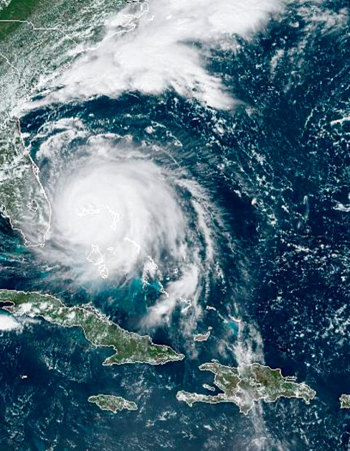
GeoXO Update for HRIT/GRB Users Group Meeting
September 2024
NOAA
National Environmental Satellite, Data, and Information Service

Slide 2
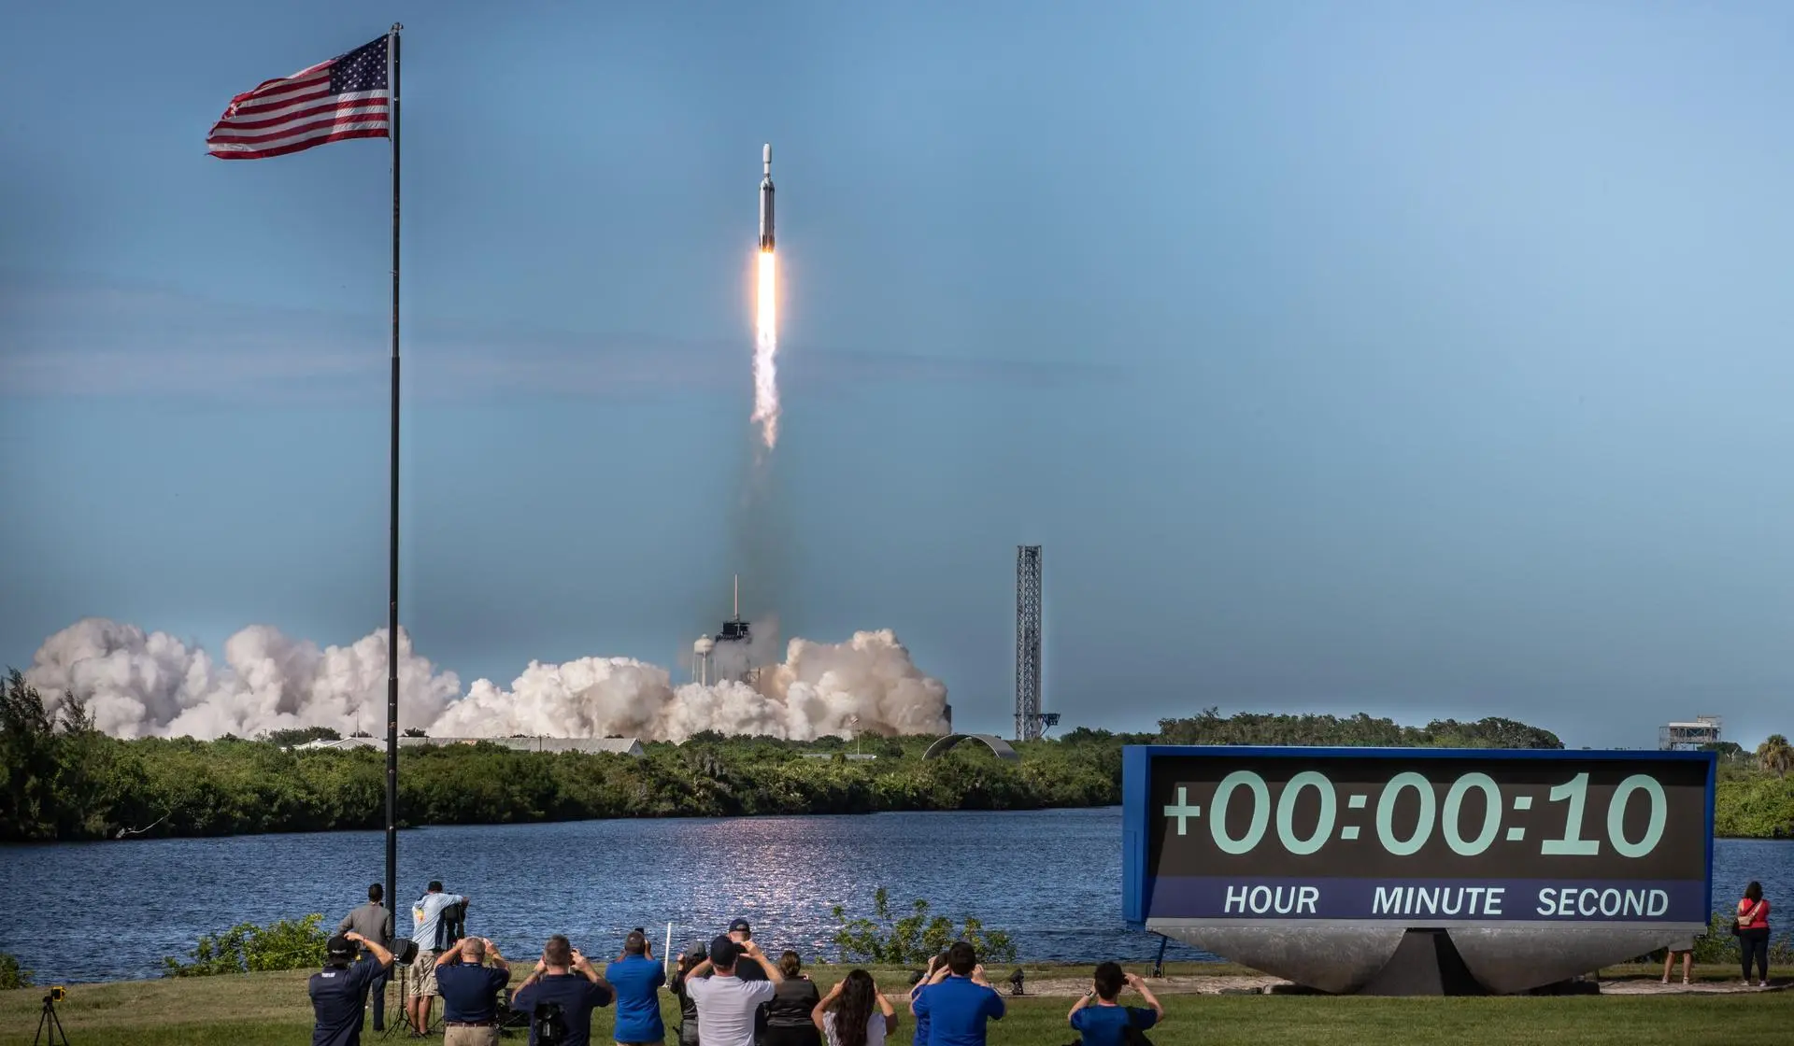
GOES-R Development Ends, GeoXO Begins
The last GOES-R satellite, GOES-U (now GOES-19), launched in 2024
While GOES-R satellites will operate into the 2030s, replenishment is needed in 2032 for continuity
To provide continuity after GOES-R, in 2020, NOAA began planning its next-gen system by surveying user needs and defining requirements
In 2022, the new GeoXO program was approved for implementation by the Dept of Commerce
2022 DOC Decision
Memo baselining
GeoXO and approving implementation
GOES-U was launched on June 25, 2024!
Notes:
Take away Chart
Michael Lewis's book (the 5th risk) "We ran the no-satellite experiment in Galveston in 1900... ten thousand people died."
Note: To calculate the yield:
* $162 Billion of Forecast impact to Global Economy - directly from the WMO/World Bank analysis*:
* 77% of the $162 Billion is from SPACE BASED ASSETS = 0.77 X 162 = $124 B
* 45% of the Contribution is from US assets = 0.45 X 124 =$55.8 B
* 40% of the US data impact is from GEO assets = 0.39 x $55.6B = $21.7 B/yr: Therefore 20X the $20B investment
Note: 39% is from FSOI in OSSE: Geo Percentage of impact to Forecast
To Calculate the percentage benefit: $21.7B/$162B = 13.7%
*From WMO/Worldbank publication “The Value of Surface-based Meteorological Observation Data”

Slide 3
NOAA Satellite Operations
Facility, Suitland MD
Command and Data Acq.
Station Wallops VA
Consolidated Back-Up, Fairmont WV

Slide 4
?

Slide 5
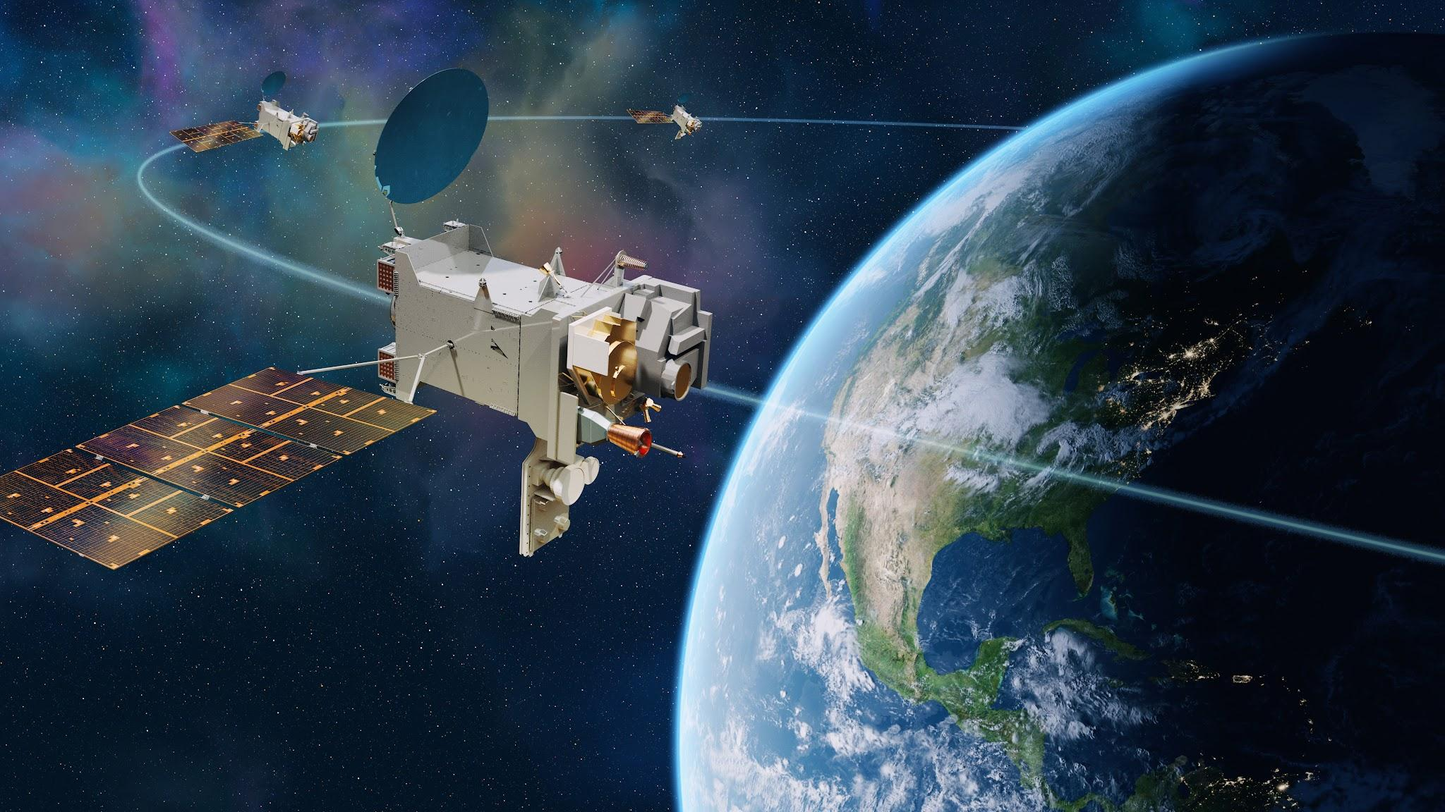
GOES Central
Sounder
Atmos. Comp
Partner
GOES E/W
Imager
Lightning Mapper
Ocean Color
GeoXO Constellation

Slide 6
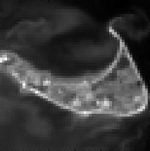
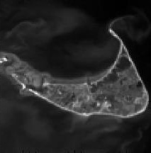
GOES-R ABI versus GeoXO Imager (GXI)
Nantucket Island at ABI 0.5km vs GXI 0.25km Resolution

Slide 7
GeoXO Timeline
User Reqts
Working
Group
Convened
NOSC
Endorses
Observation
Set
GeoXO-I1
Launch
We are here
Form.
Auth.
KDP
A
KDP
dA
Contract
Awards
KDP
B
KDP
C
KDP
D
KDP
E
MCR
SRR
MDR
PDR
CDR
SIR
ORR
FY20 | FY21 | FY22 | FY23 | FY24 | FY25 | FY26 | FY27 | FY28 | FY29 | FY30 | FY31 | FY32 | FY33
MS0
MS1
MS2/3
(DOC Baseline)
Congressional Baseline
Ops
Pre-formulation
Formulation
Implementation
Implementation contracts:
Imager: L3Harris
Sounder: BAE Systems
Atmo. Comp.: BAE Systems
Ocean Color: BAE Systems
Spacecraft: Lockheed Martin
- Lightning Mapper: target award September 2024

Slide 8
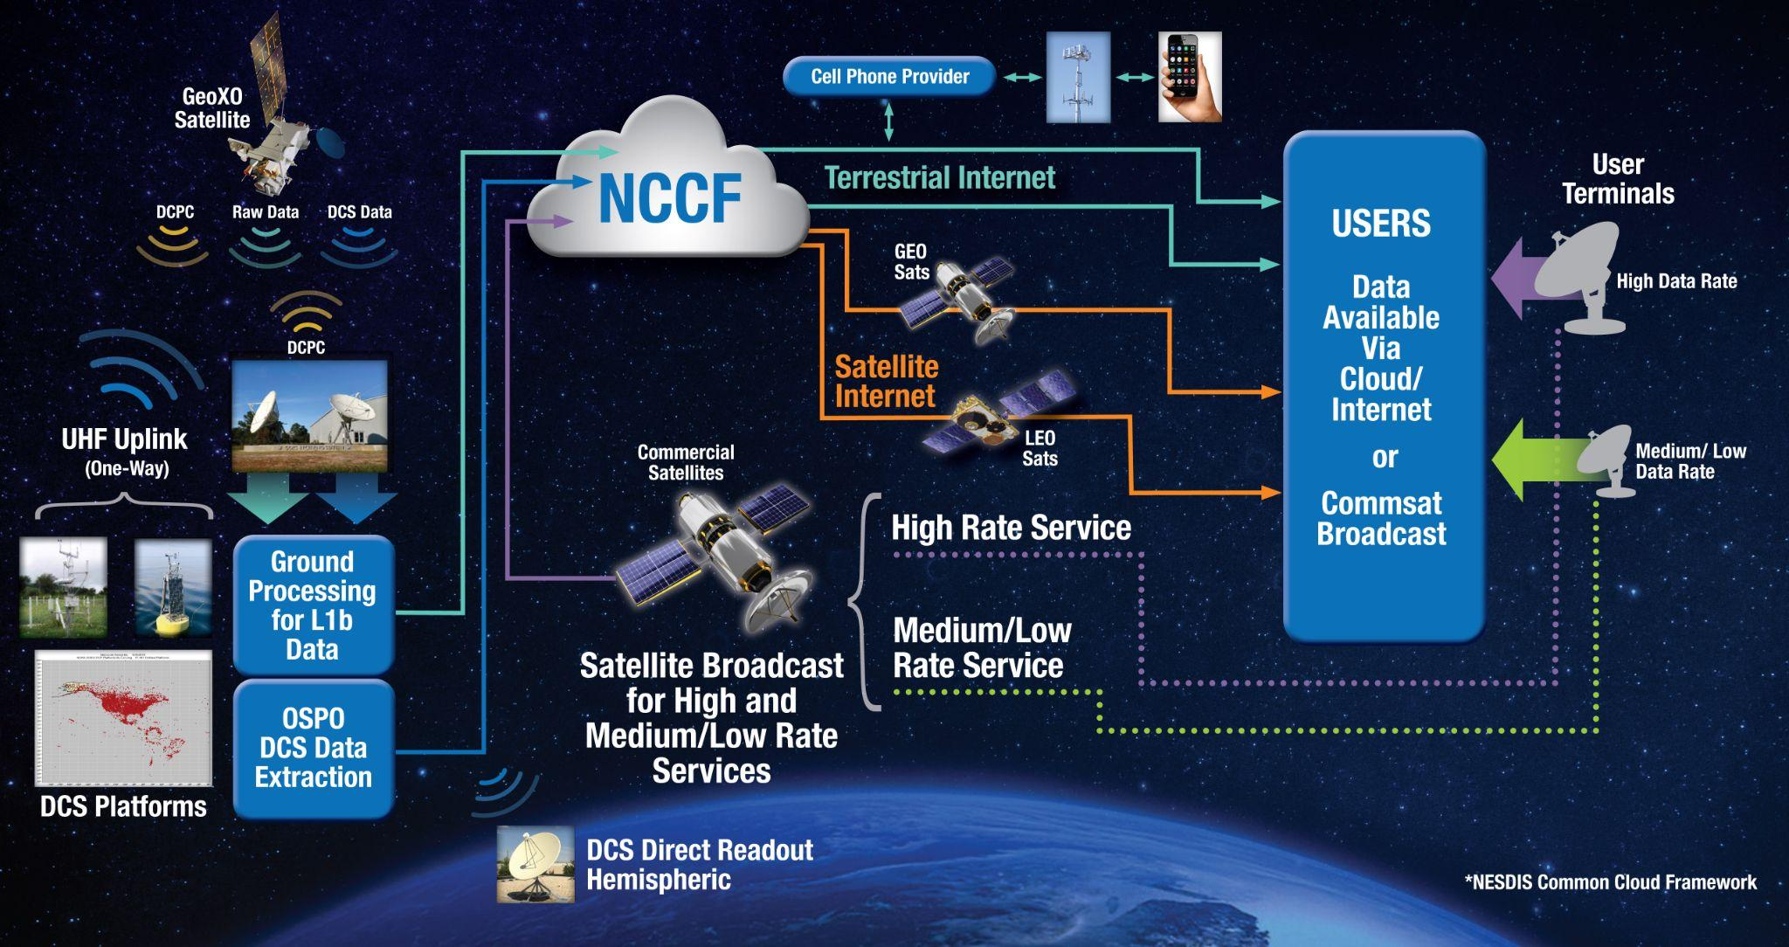
Accessing Data from GeoXO

Slide 9
Access Over the Air: User Facing Communications
GOES-R Service | GeoXO Service | User Facing Changes, Upgrades or Modifications
DCS Platform Signal Rx (DCPR) | DCS Platform Signal Rx (DCPR) | None. DCPR services will continue on the same frequencies as GOES-R.
DCS Rebroadcast (DRGS) | DCS Rebroadcast (DRGS) | Users antennas or filters may require minor modification for shifted DCS DRGS frequencies which provide bandwidth margin from proposed L-band spectrum sharing. GOES-R L-Band Frequencies: 1679.9 (U.S. Domestic) 1680.2 (International) GeoXO L-Band Frequencies: 1691.9 (U.S. Domestic) 1692.2 (International
DCS 2-way commanding (DCPC) | DCS 2-way commanding (DCPC) | None. DCPR services will continue on the same frequencies as GOES-R. DCPC receivers in development are compatible with GOES-R and GeoXO.
EMWIN/HRIT Broadcast | Medium/Low Rate Service | Users will need to replace existing L-Band receivers and antenna with new systems compatible with selected commercial frequencies. Costs for receive hardware to be borne by users. Service will continue to be free of charge. Receive systems are expected to be equivalent if not lower in cost than existing systems. Service footprint may be limited due to availability of commercial beams, but intent is to service as many existing users as possible.
GOES-R Rebroadcast (GRB) | High Rate Service
Notes:
Transition to Daniel Gillies

Slide 10
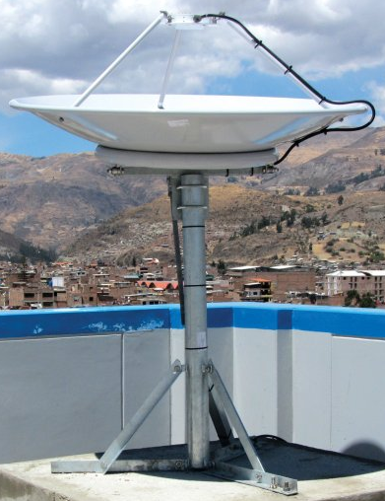
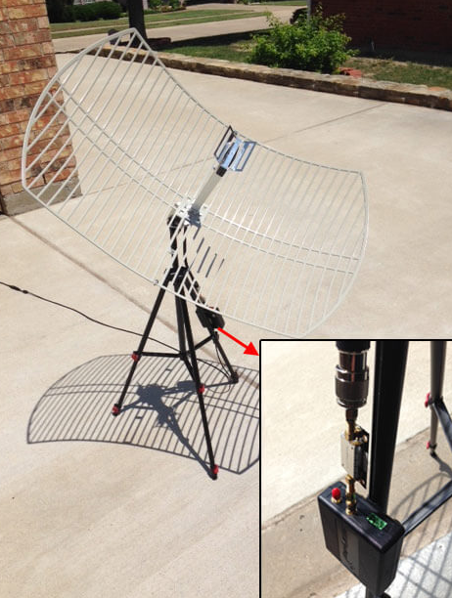
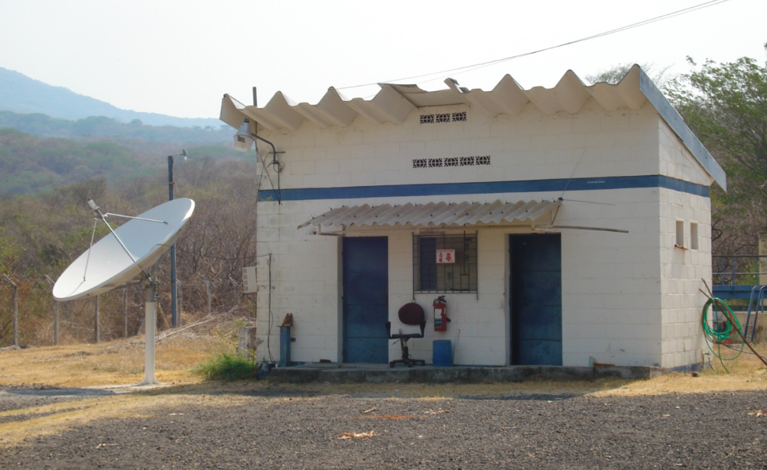
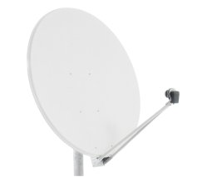
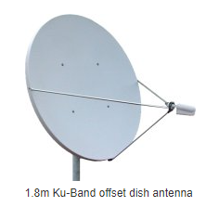
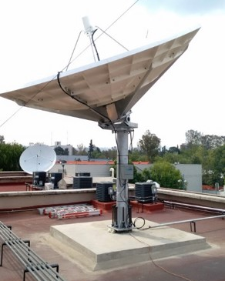
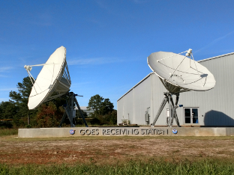
GOES-R to GeoXO: User Equipment Updates
GOES-R Access
GeoXO Access
(with current system examples)
(with examples from equivalent services)
HRIT/EMWIN
“Professional” (Left) & Low Cost (Right) HRIT/EMWIN Antennas
C-Band (GNC-A Service)
GRB
Typical GRB Receiving Antennas
1.25m Ku (Eumetcast Service)
1.8m Ku (Eumetcast Service)

Slide 11
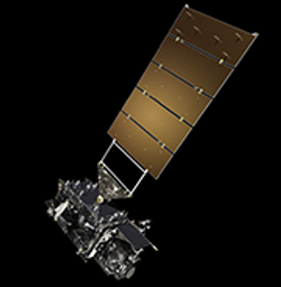
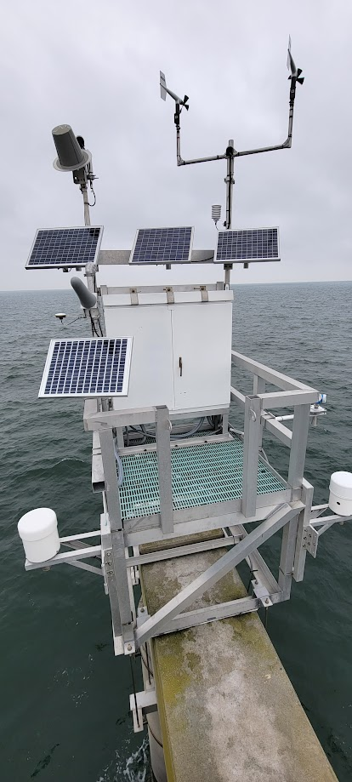
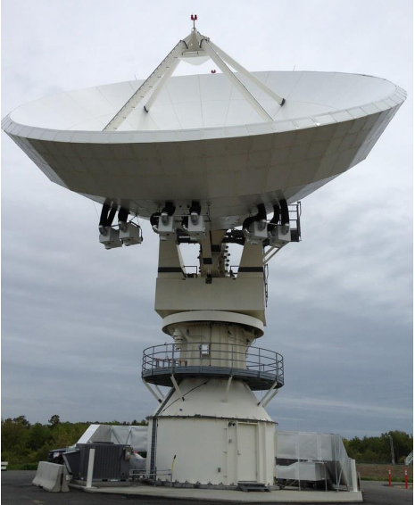
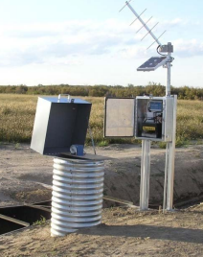
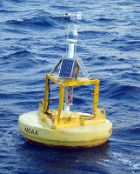
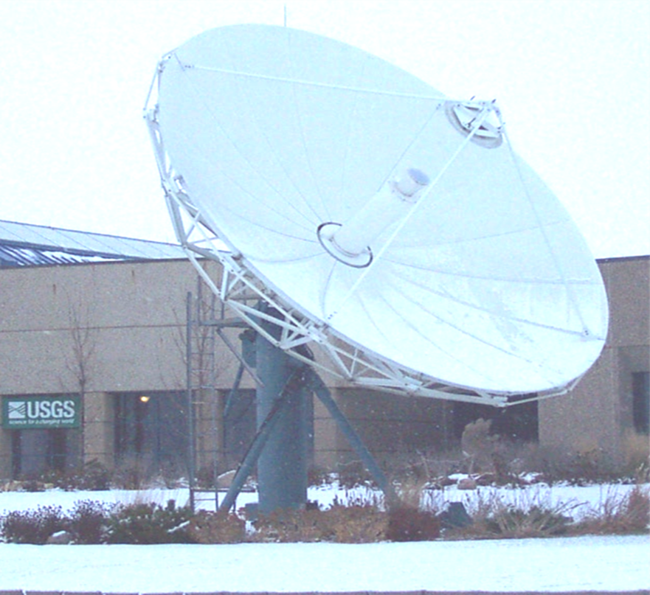
Data Collection System
GEO-West
GEO-East
Command
(DCPC)
Data
(DCPR)
Command
(DCPC)
Data
(DCPR)
Hemispheric Real-Time Coverage (> 5 deg El)
Free to Use Data Relay
32,000+ Active Platforms
Weather Stations, Flood Gauges, Fire Monitoring, Tide Levels, Tsunami Monitoring, Wildlife Monitoring, Buoys (In Dev.), Geomagnetic Sensors, Custom Sensors
New Environmental Use Cases Welcome!
william.dronen@noaa.gov & daniel.gillies@noaa.gov
Data Collection Platform
DCPR (401.7-402.1 MHz)
DCPC (468.8 MHz)
User Direct Ground
Downlink: L-Band
NOAA Ground
Uplink: S-Band
Downlink: L-Band

Slide 12
User Facing Comms - Market Research
NOAA is currently in the process of conducting market research on commercial broadcast solutions for the GeoXO High Rate (GRB follow on) and GeoXO Medium/Low Rate (HRIT/EMWIN Follow on)
Approximately 3-4 responses are expected to provide a commercial ‘best equivalent’ to GOES-R services
For the High Rate Service: Initial feedback points towards Ku solution
When making trades on coverage, we are prioritizing existing GRB receiver locations
N/C/S America + Hawaii & Alaska
Please respond to the GRB survey!
For the Medium Rate Service: Initial feedback points to C or Ku
Already have strong user demand for maritime coverage - goal is to replicate as close to GOES-R coverage area as commercially feasible
We are planning on providing an update on these activities formally at the GeoXO MDR in December

Slide 13
User Engagement
NOAA is currently holding a monthly requirements working group with the DoD community, in support of keeping receiver development programs in-sync with current NOAA plans
Considering creating a similar forum for civil users - will look towards GRB and HRIT survey responses to assist in identifying outreach opportunities
We have also participating in outreach at the following events:
AMS 2024
GeoXO South Florida Roadshow
Provided materials for WMO briefings
Eumetsat 2024 (later this month)
While User Facing Comms outreach has been performed by GeoXO Program Systems Engineering, we are working on incorporating it formally into the GeoXO User Engagement plan → more directed engagement to discuss RF & cloud distribution

Slide 14
Inclination Drift on GOES-R Series
As a fuel saving measure on GOES-R series, NOAA plans to allow the inclination of the GOES-R spacecraft to ‘drift’ when they approach end of life
5-degrees maximum ‘drift’ has been determined to be a ‘sweet-spot’ between fuel savings and operational/technical complexity
North-South stationkeeping (NSSK) will be ceased at ~ 6 years prior to end of life → time it takes to reach 5 degree drift = 5 degree inclination
Performed on on previous missions (e.g. GOES-10, EWSG)
Current GOES-16 EOL is 1Q 2033, thus need to stop NSSK at the end of Oct 2030 → Extends life to 2036
It is expected GOES-16 will be in storage at this time
Potential for impact to DRF comms services users who use directional antennas without tracking capability

Slide 15
Location vs. Impact
+5 Deg North
Potential impacts of inclination float on user facing auxiliary communications can be broken into three categories based on user site location
A) Locations well within coverage area
Sites with > 10 deg of elevation to equatorial GOES
Primarily driven by receiver / transmitter antenna patterns / margin
Omni-directional systems not impacted (i.e. SARSAT Uplinks, some DCPR)
Highly directional antennas may experience decrease in link margin without tracking
B) Locations near Northern / Southern Edges of Coverage Area
Sites with < 10 deg of elevation to equatorial GOES
Same primary drivers as A, but low elevation angle sites should consider local obstacles (terrain, buildings, etc)
During a portion of day, sites will be outside “official” coverage area from spacecraft
C) Locations at Northern / Southern Edges of Coverage Area
Sites near 5 deg elevation ( < 5 deg not “officially” covered by GOES)
Represented by the lines at left
These sites will be outside of official coverage area for half of the day
Greatest risk of loss of coverage
Equatorial
- 5 Deg South

Slide 16
Initial Assessments
Auxilliary Comms Service | Coordination Notes
DCS: DCPR Uplink | Primary concern are for sites at edge of current coverage, Cat B/C locations; However, know of DCPs outside of “official” coverage area that currently close link. While those may be impacted, lowers risk for “officially” covered sites.
DCS: DCPR Downlink - DRGS | Majority of DRGS likely well within coverage area. Receive antennas likely have sufficient margin to make up for GOES drift, but user coordination needed. Larger aperture receive antennas have higher risk of link impact if tracking not available.
DCS: DCPC | Not currently operational, but link budgets show significant margins which can be leveraged for low elevation angle sites.
GRB: Downlink / Direct Readout | Currently engaging with major GRB users; Initial feedback is that many major GRB players have antennas with tracking capability. For those without, will continue coordination and support link assessments. By 2030s, expect GRB data to be available by IP (NCCF) as an alternative.
HRIT/EMWIN: Downlink | Researching HRIT/EMWIN receivers – initial feedback from one major manufacturer indicated up to 5 degrees of off-pointing resulted in no significant packet loss. Low-cost receivers could be at greater risk, especially in Category B/C locations. Continuing user coordination.
SARSAT not included as timeframe for inclination drift is well beyond initial MEOSAR IOC date

Slide 17
User Facing Comms - Summary
NOAA will continue to provide User Facing Communications “Over the Air” using Commercial Broadcast Services
These services will be free to use - with low cost user provided receivers
Due to changes in band, users will need to update hardware for GeoXO (NET 2032)
NOAA is evaluating ways to reduce h/w cost for continued use of GOES-R broadcasts
GeoXO High Rate: GXI (Imager) L1b & LMX (Lightning) Data
GeoXO Medium Rate/Low: L2+ Products, Emergency Warnings, DCS
Interested in user feedback on services, products, and architecture
GeoXO will host the Data Collection System (Receive & Command)
Provides a real-time link for in-situ environmental data with no service cost to users
New users & applications welcome!

